Slide 1
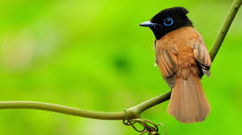
NATIONAL LEVEL WORKSHOP ON ADVANCED RESEARCH STUDIES IN LIFE SCIENCE – GAPS AND SCOPE
ORGANIZED BY
DR. N. EZHILARASI
ASSISTANT PROFESSOR
PG AND RESEARCH DEPARTMENT OF ZOOLOGY
GOVERNMENT ARTS COLLEGE
COIMBATORE

Slide 2
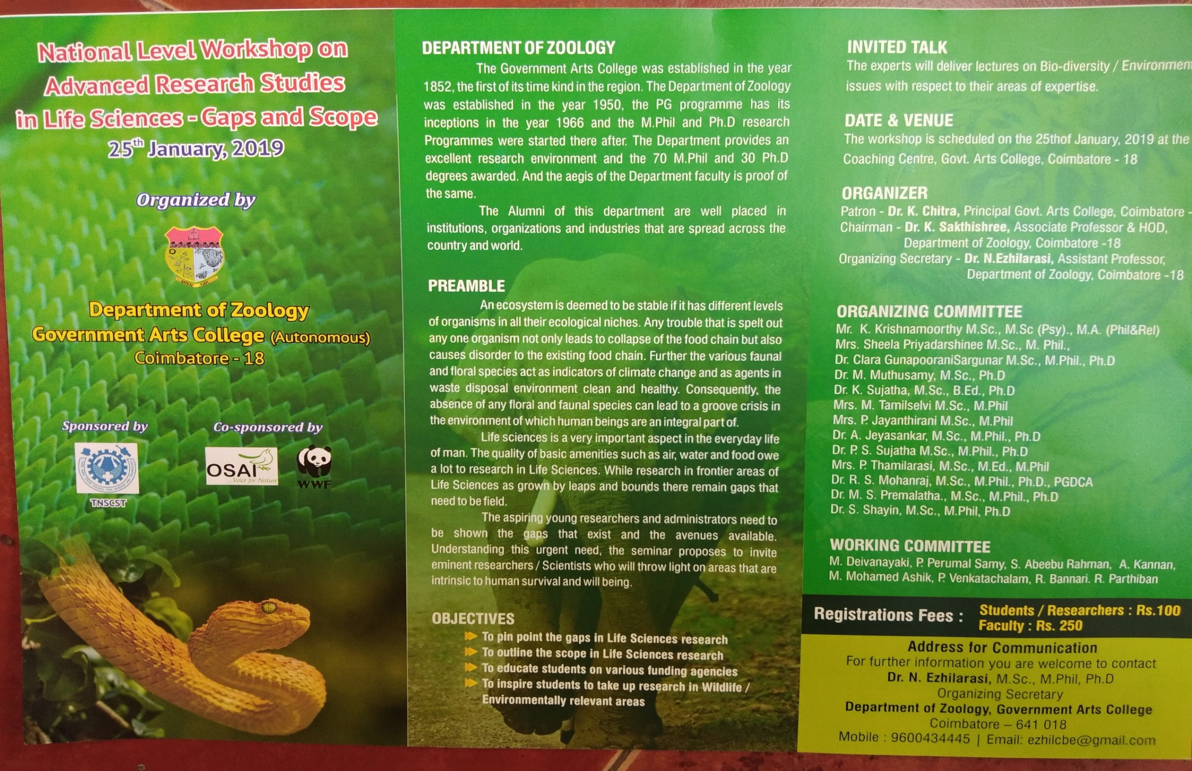
BROCHER

Slide 3
WORKSHOP SHEDULE
Time | Sessions | Resource Person
09.30- 10.30 | Inauguration | Thamizhthaai Vaazhthu, Lighting of Kuthuvilakku,
 | Welcome Address | Dr. N. Ezhilarasi, M.Sc., M.Phil., Ph.D., Organizing Secretary
 | Keynote Address | Dr. K. Sakthi Shree, HOD
 | Presidential Address | The Principal, Government Arts College, Coimbatore
 | Chief Guest Address | Mr. D. Boominathan, Landscape Coordinator, WWF, New Delhi
 | Felicitation Address | Mr. K. Kalidasan, President , OSAI Environmental Organization, Coimbatore
10.30-10.45 | Tea Break
 | Technical Session – I
10.45-11.30 pm | Mr. K. Kalidasan, President, OSAI, Coimbatore. | Gaps and Scope in Environmental issues
11.30-12.30 | Mr. A. Ajay Desai, Elephant Scientist, WWF, New Delhi. | Gaps and Scope in conservation issues
12.15-1.00pm | Mr. A. Pavendhan President, The Nature and Butterfly Society (TNBS) and members, Coimbatore Nature Society | An introduction to Birds and Gaps & opportunities in Ornithology
01.00 – 2 pm | Lunch Break
 | Technical Session – II
02.00- 02.45pm | Dr. B. Ramakrishnan, Assistant Professor, Department of Zoology and Wildlife Biology, Govt. Arts College, Udhagamandalam, Nilgiris. | Gaps and Scope in Mammalian studies
2.45-3.30 pm | Mr. Peter Prem Chakravarthy Biologist, ATR, Pollachi | Gaps and Scope in Big cats with special reference to Tiger
3.30-4.00pm | Valedictory Function

Slide 4
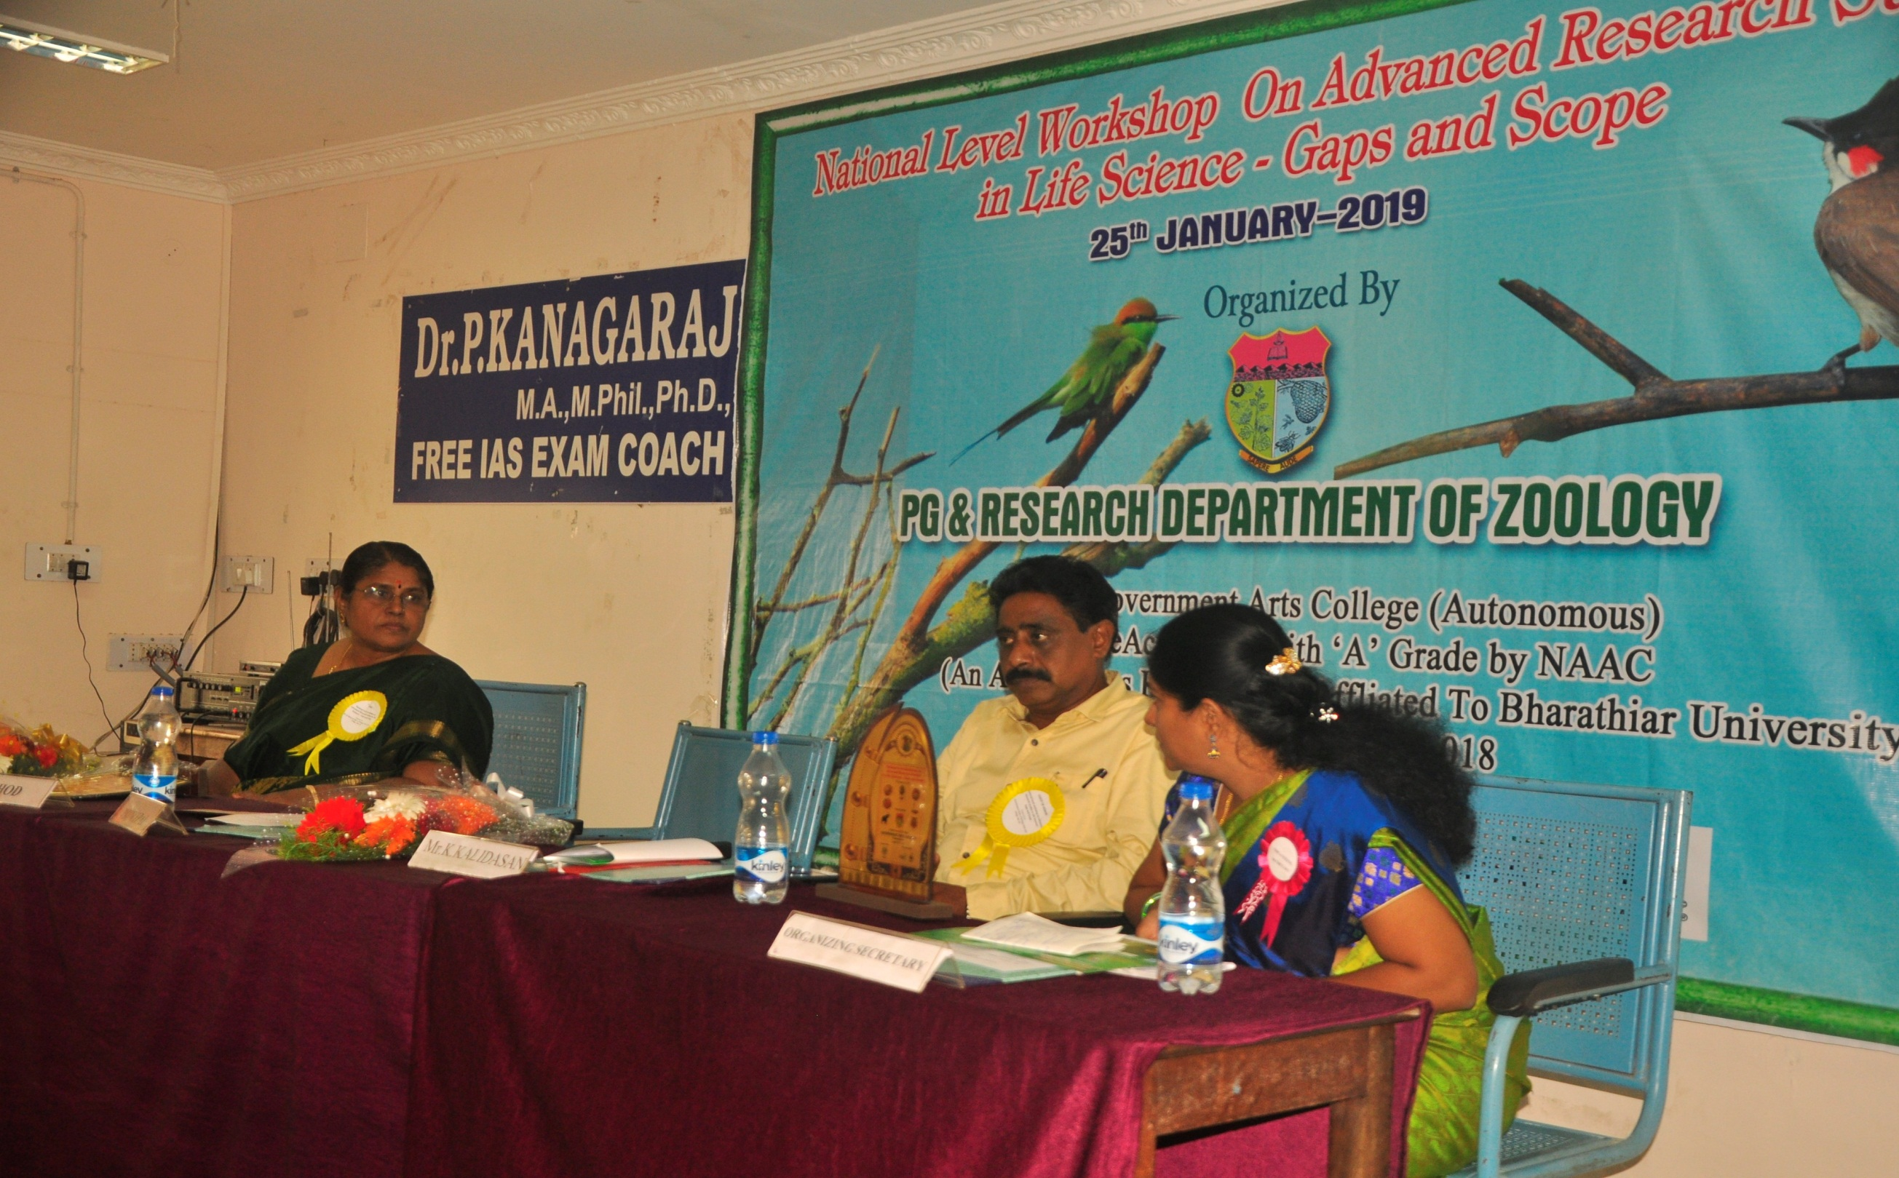

Slide 5
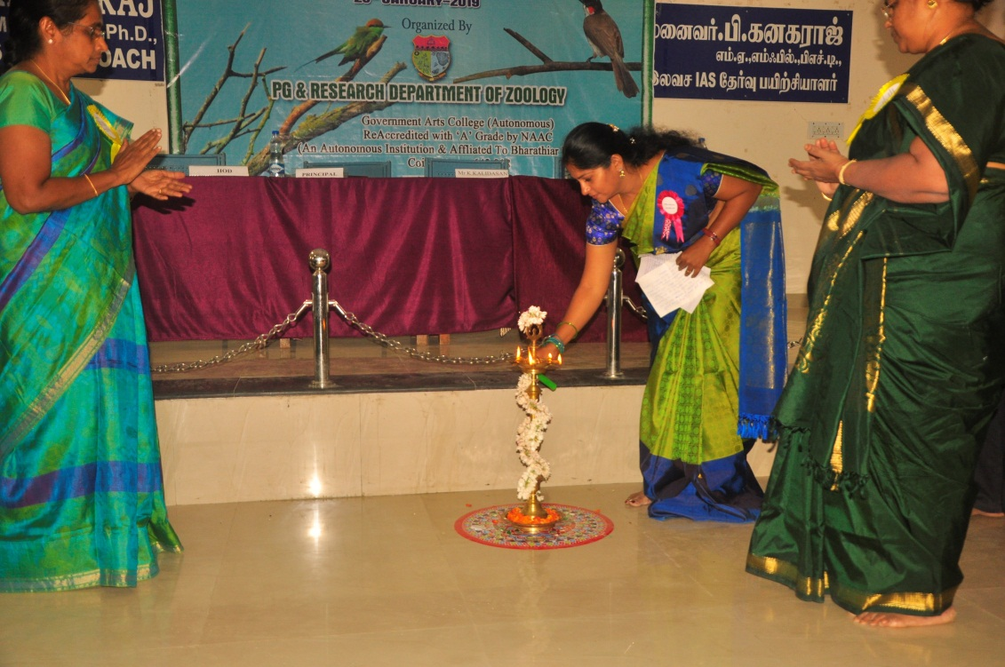
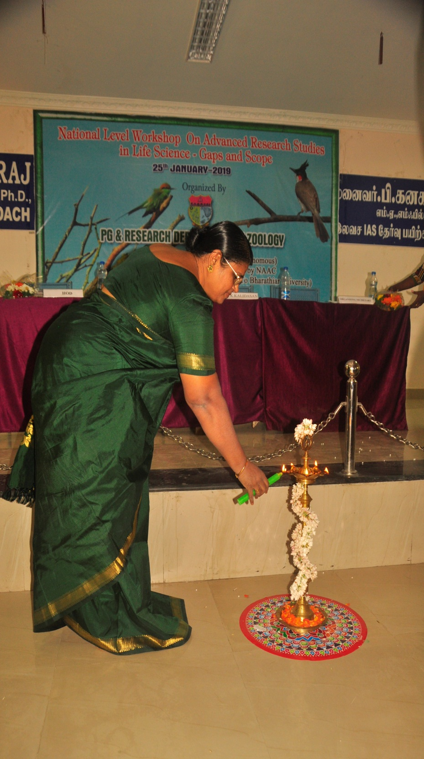
LIGHTING OF KUTHUVILAKU

Slide 6
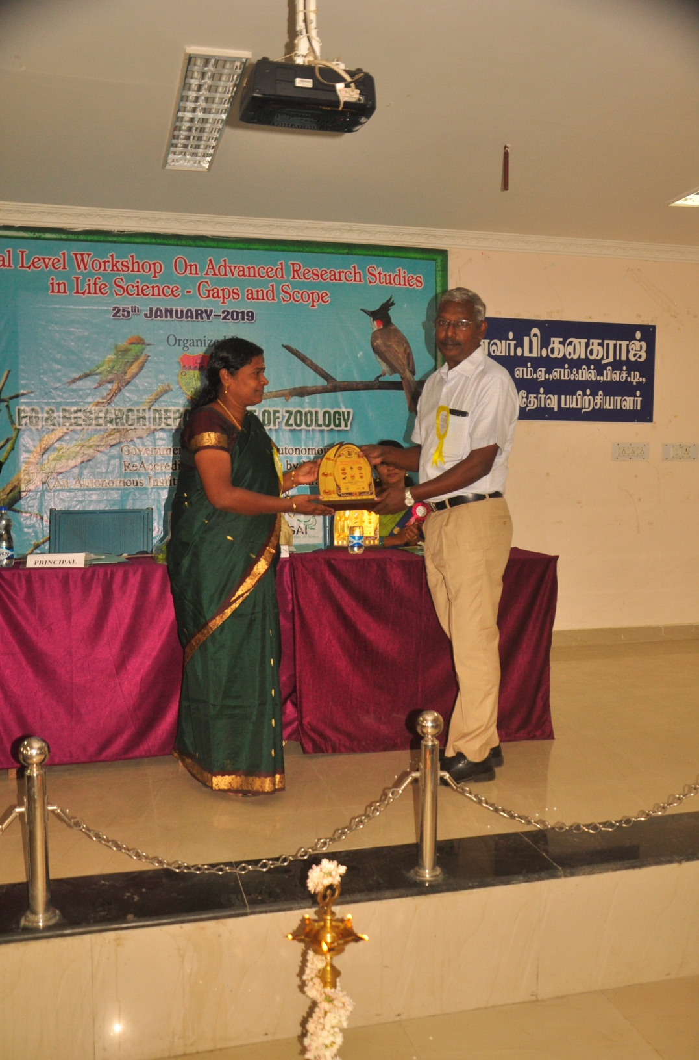
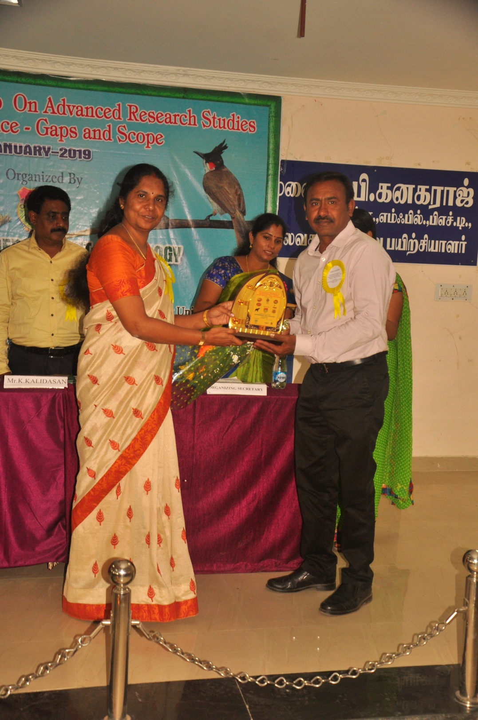
FELICITATING THE GUEST

Slide 7
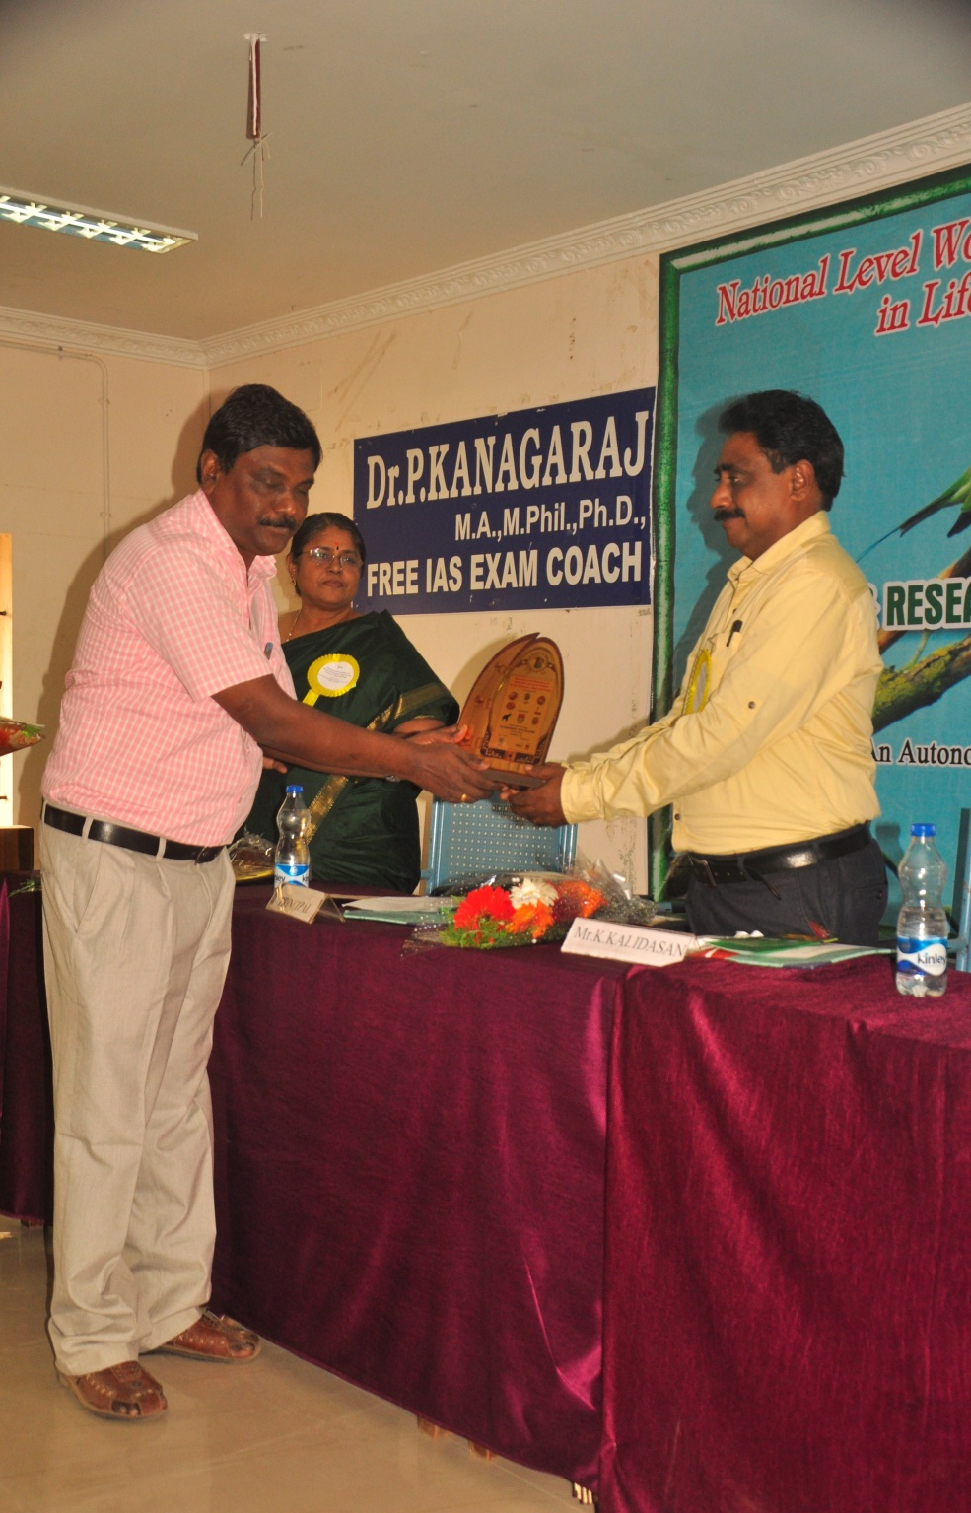
FELICITATING THE GUEST

Slide 8
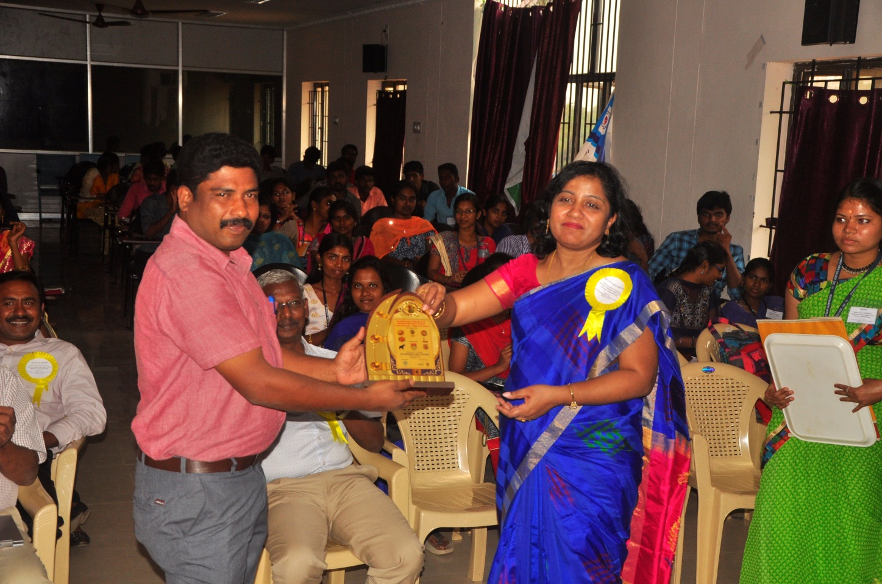
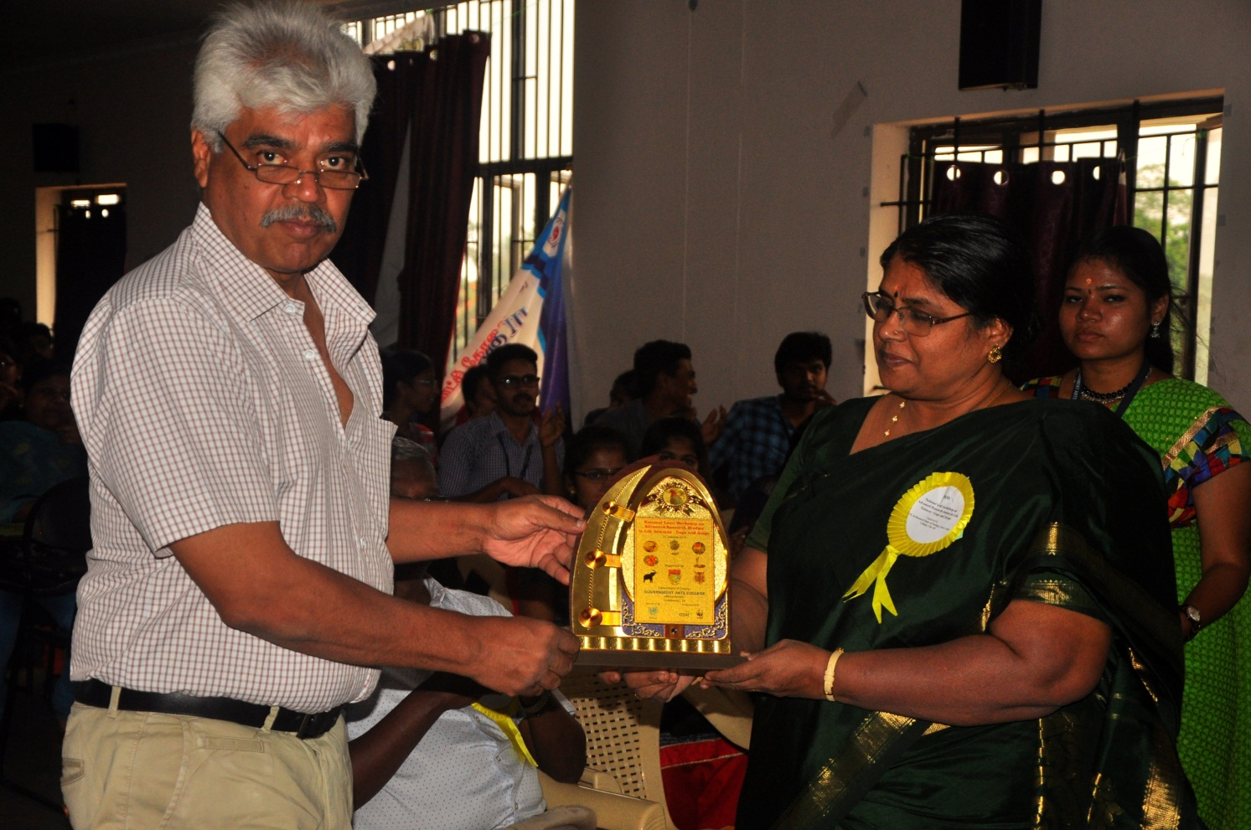
FELICITATING THE GUEST

Slide 9
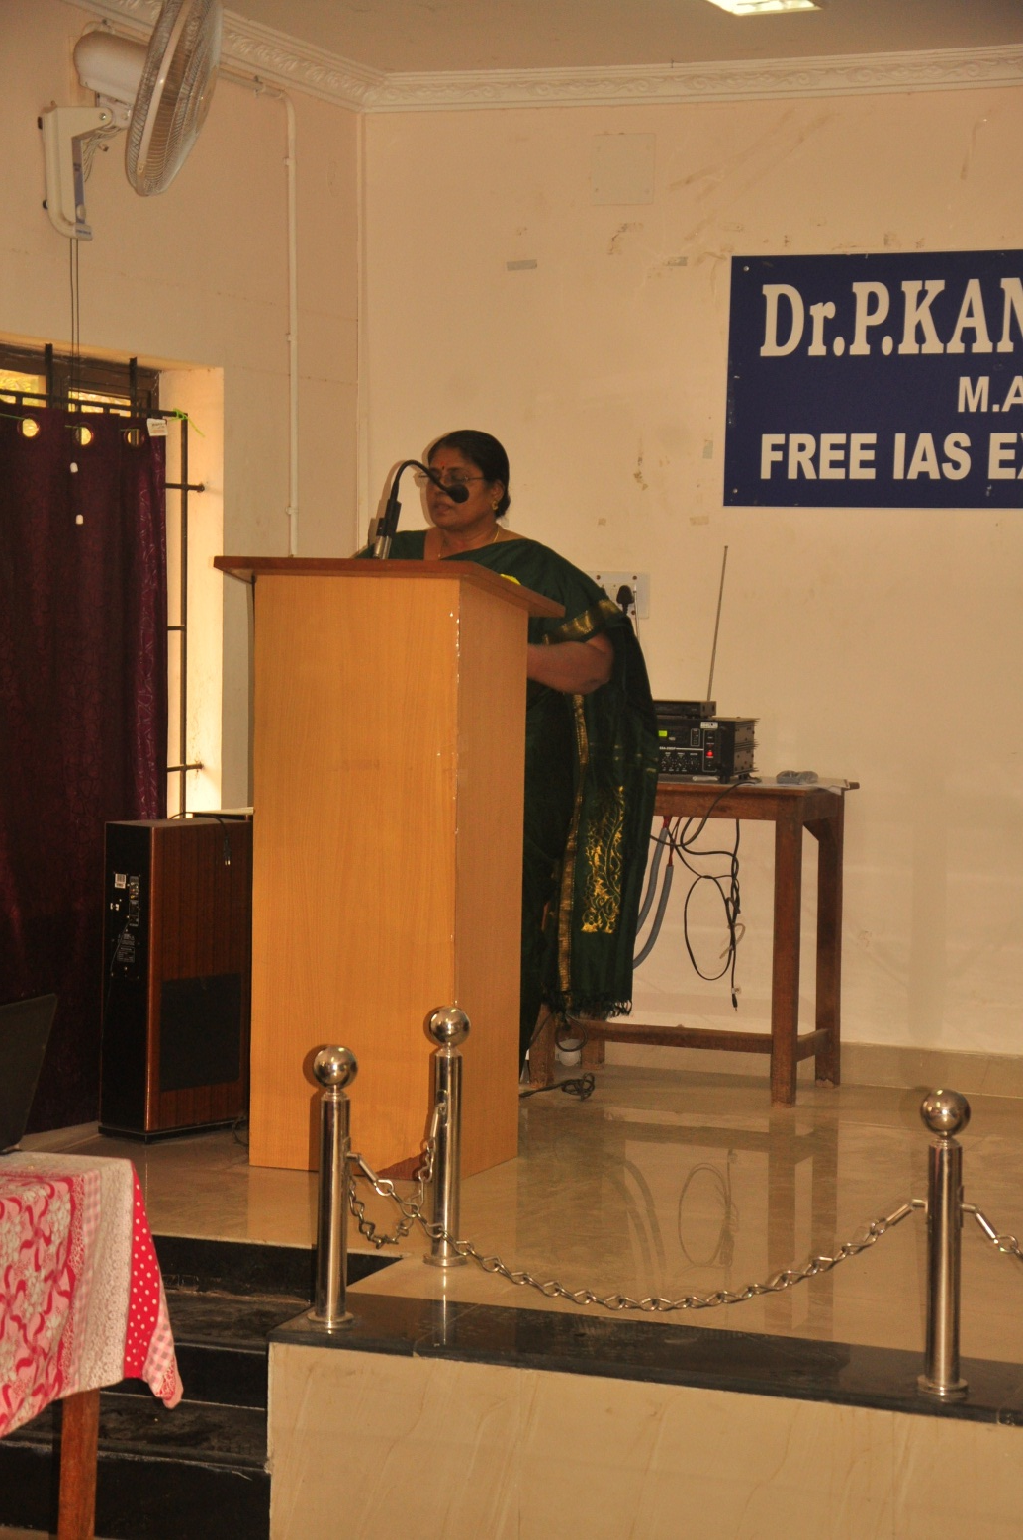
WELCOME ADDRESS BY DR. EZHILARASI
KEY NOTE ADDRESS
BY
Dr. K. Sakthi Shree, HOD

Slide 10
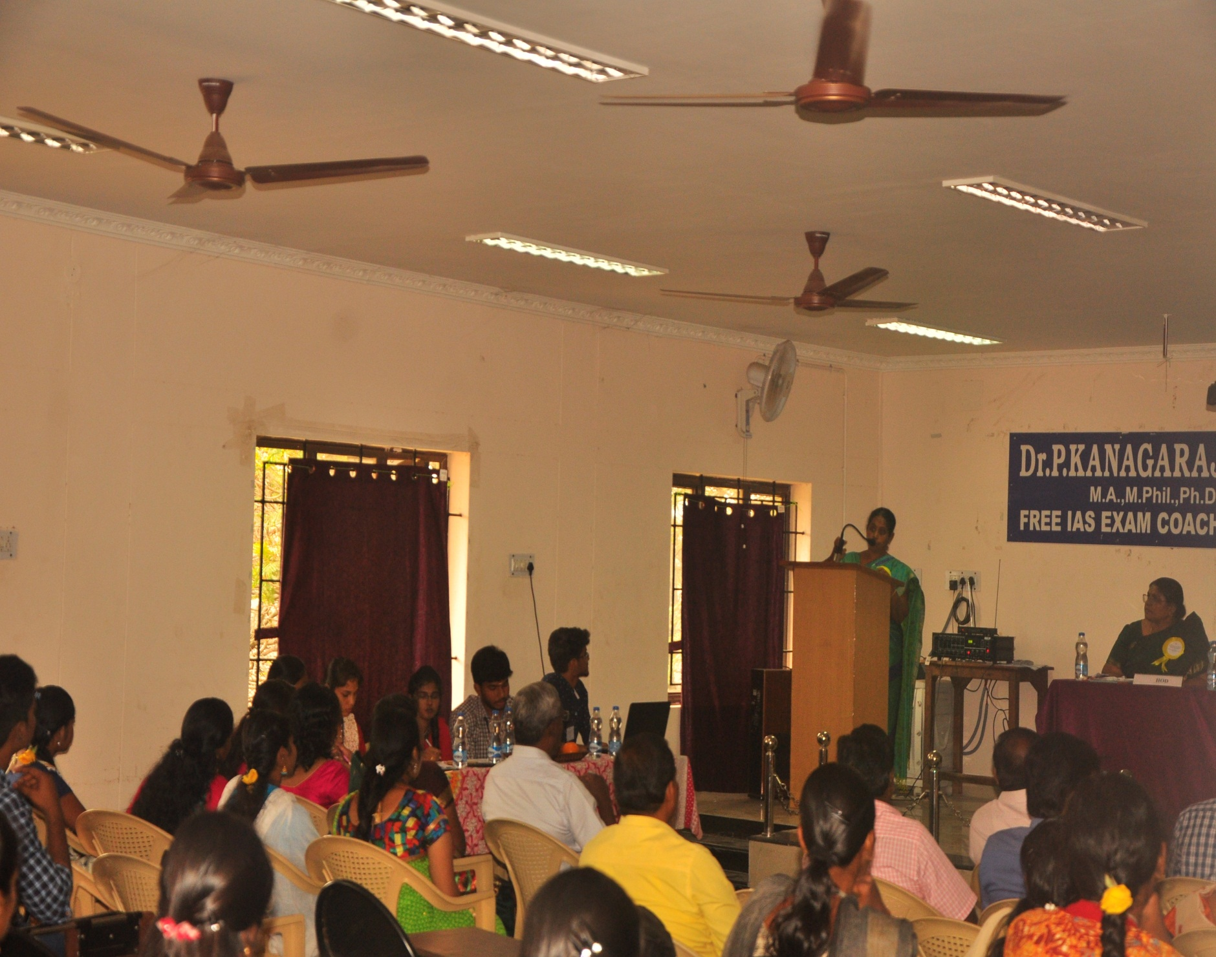
PRESEIDENCIAL ADDRES BY PRINCIPAL

Slide 11
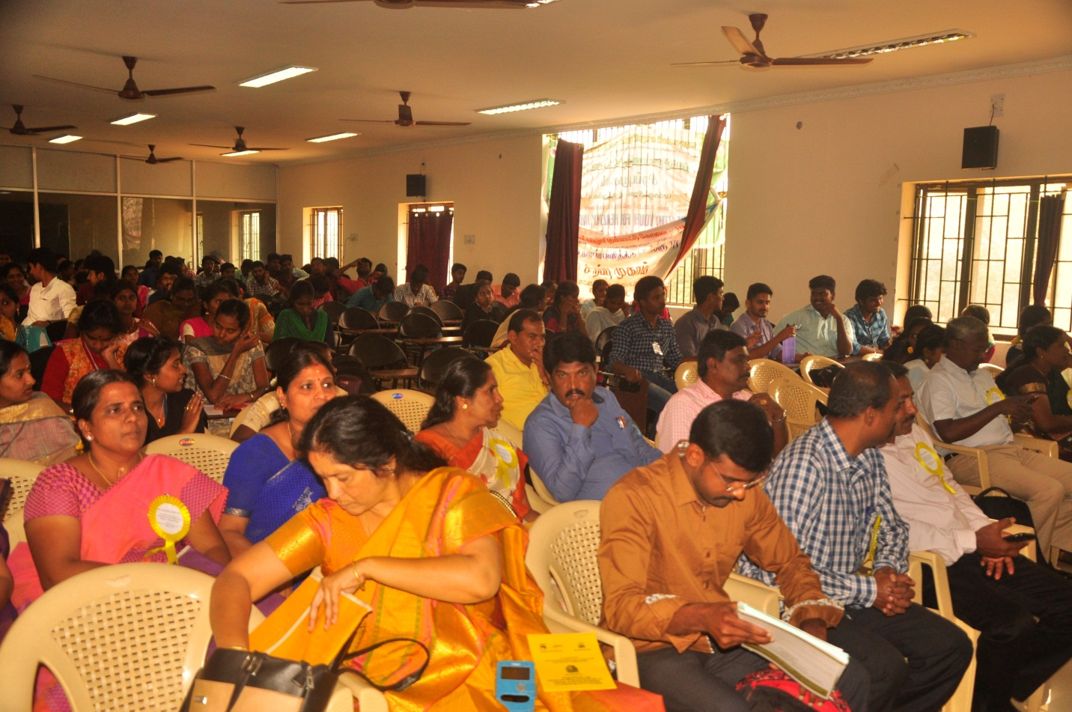
MASTER OF CEREMONY
AUDIENCE

Slide 12
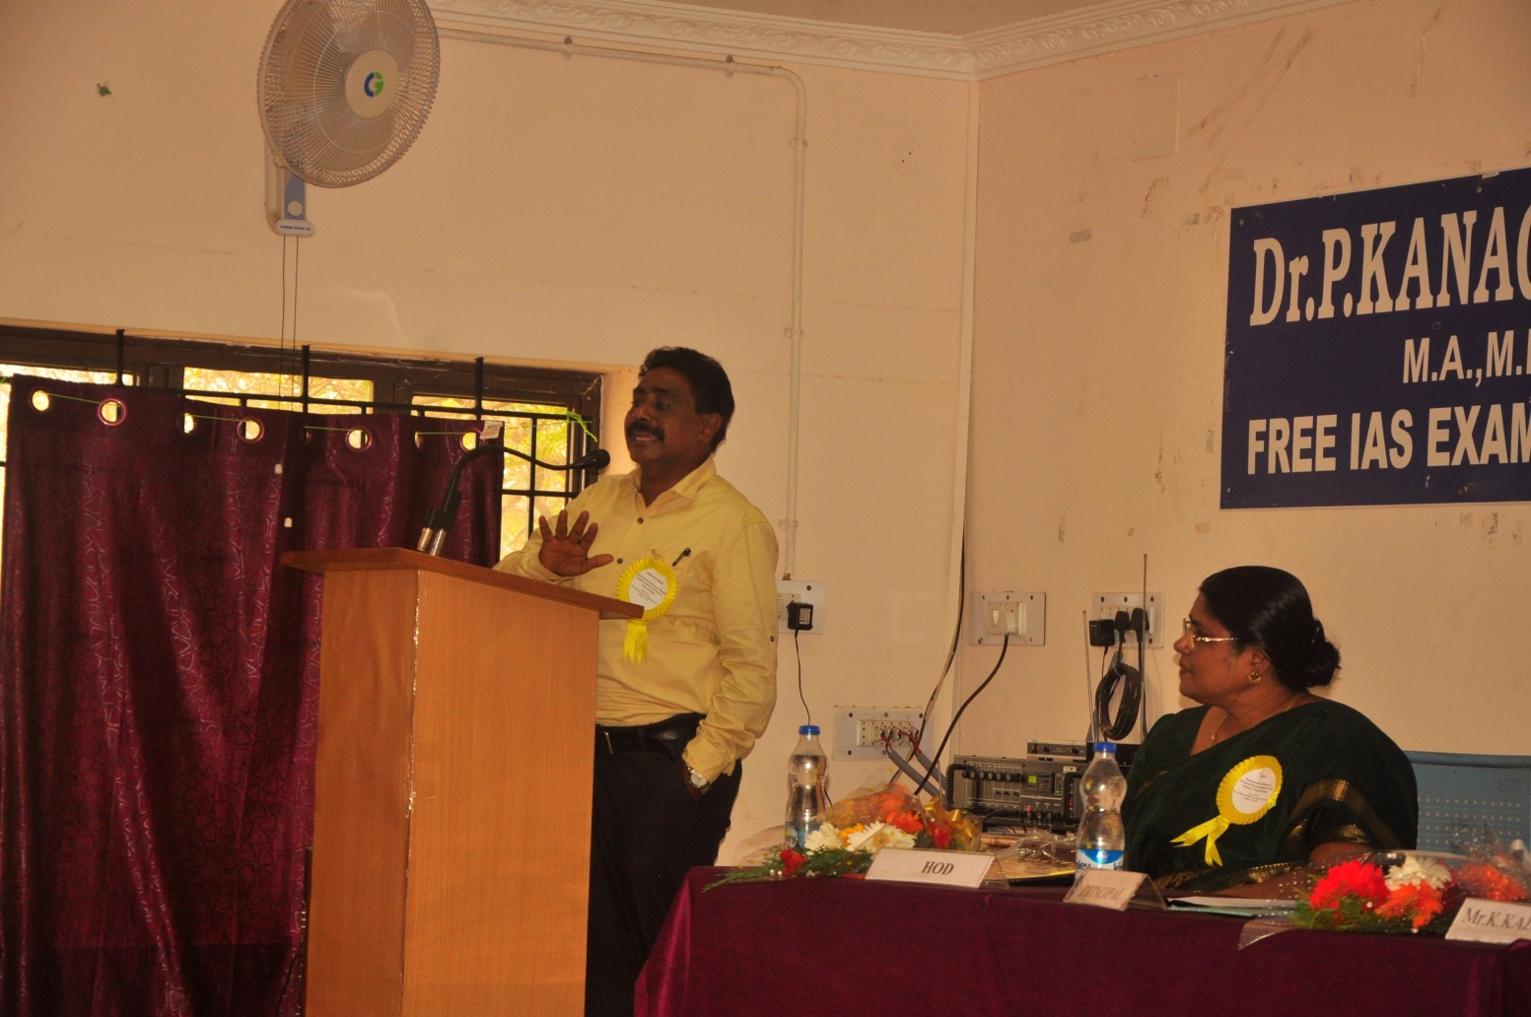
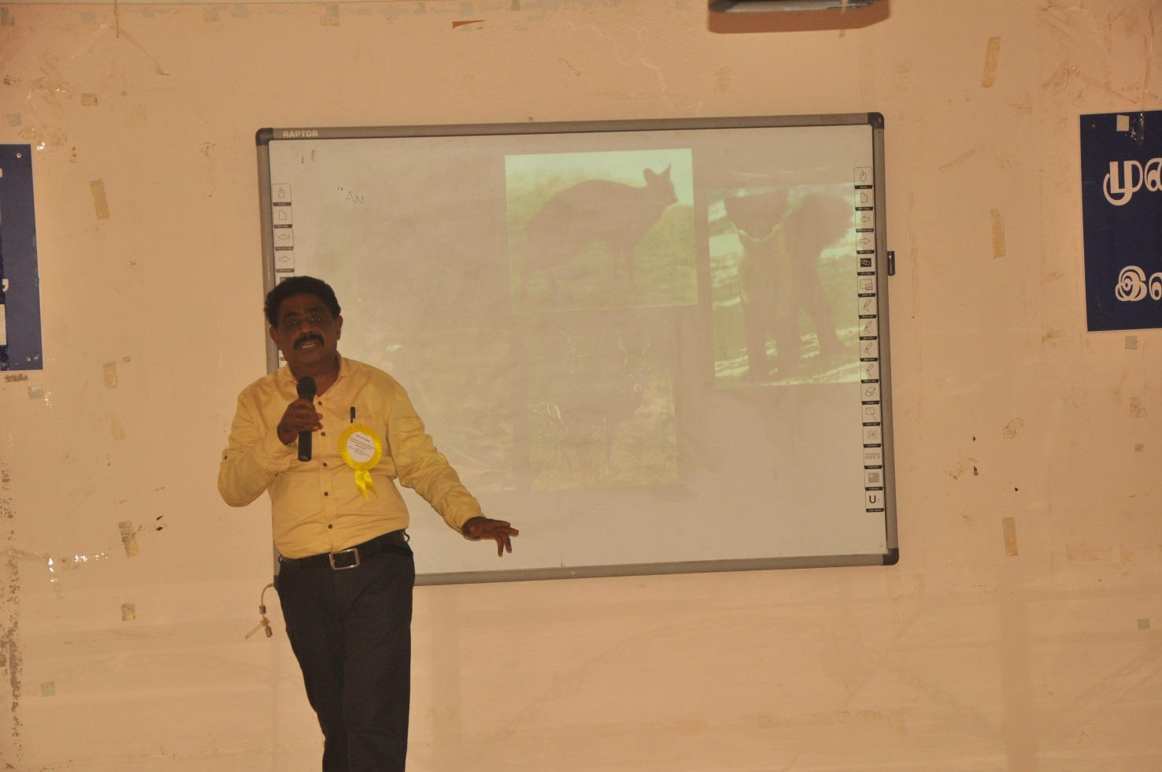
Gaps and Scope in Environmental issues
Mr. K. Kalidasan, President,
OSAI, Coimbatore.

Slide 13
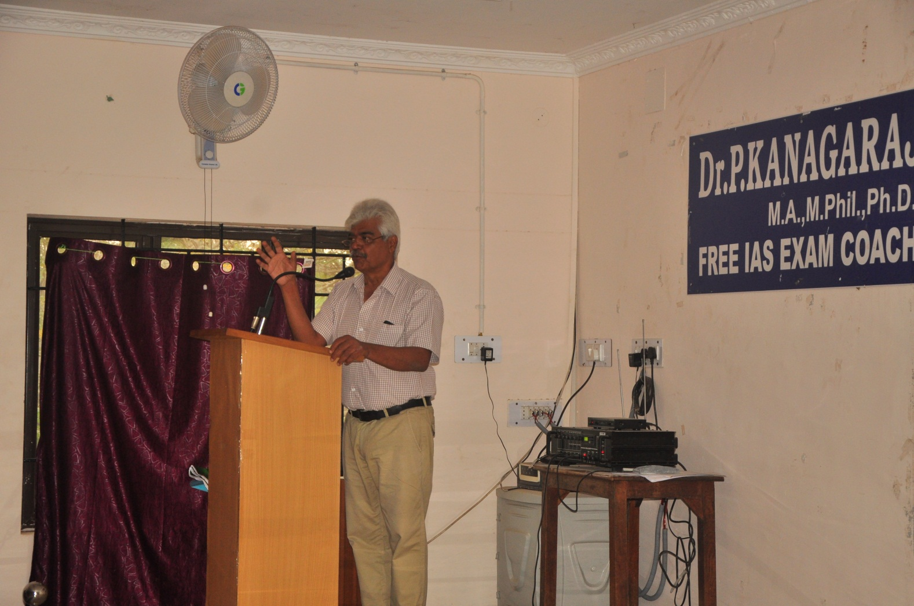
Gaps and Scope in conservation issues
Mr. A. Ajay Desai, Elephant Scientist, WWF, New Delhi

Slide 14
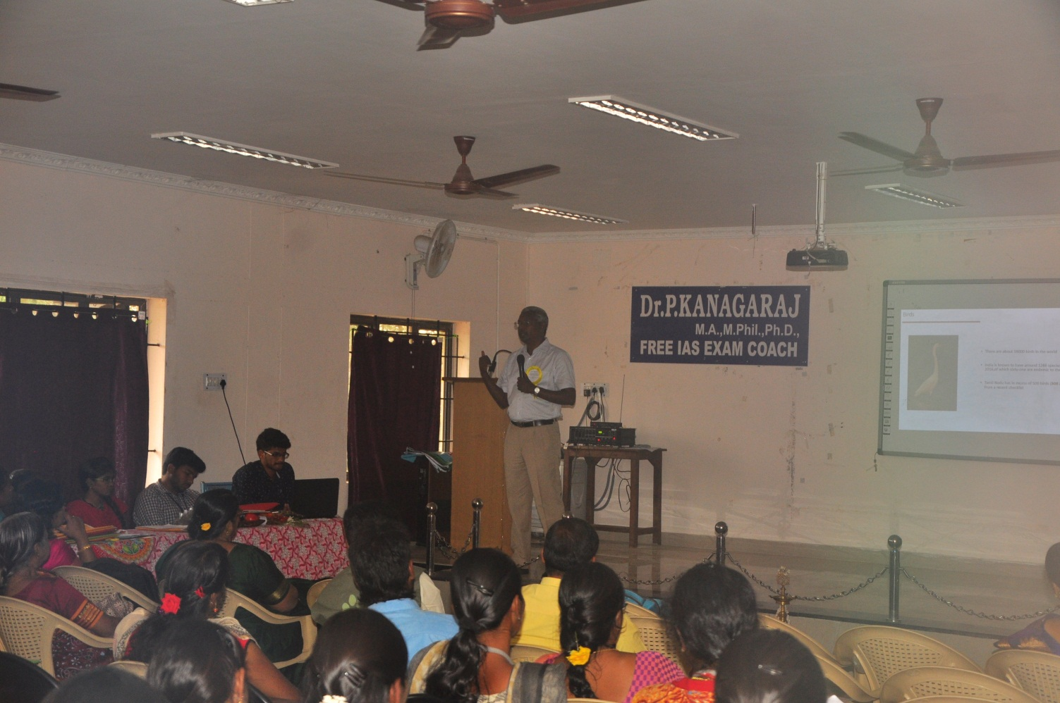
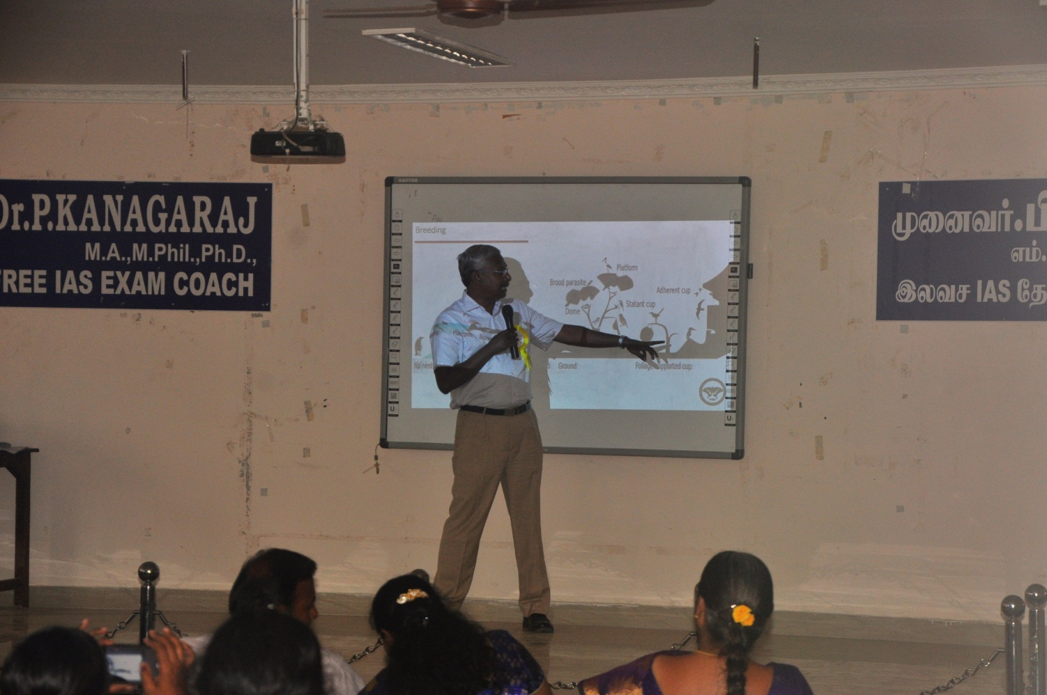
An introduction to Birds and Gaps & opportunities in Ornithology
MR. A. PAVENDHAN
President, The Nature and Butterfly Society (TNBS) and members, Coimbatore Nature Society

Slide 15
Gaps and Scope in Mammalian studies
Dr. B. Ramakrishnan, Assistant Professor, Department of Zoology and Wildlife Biology, Govt. Arts College, Udhagamandalam, Nilgiris.

